Slide 1
the criterion for a two-photon entanglement state in real space
Jieyu You

Slide 2
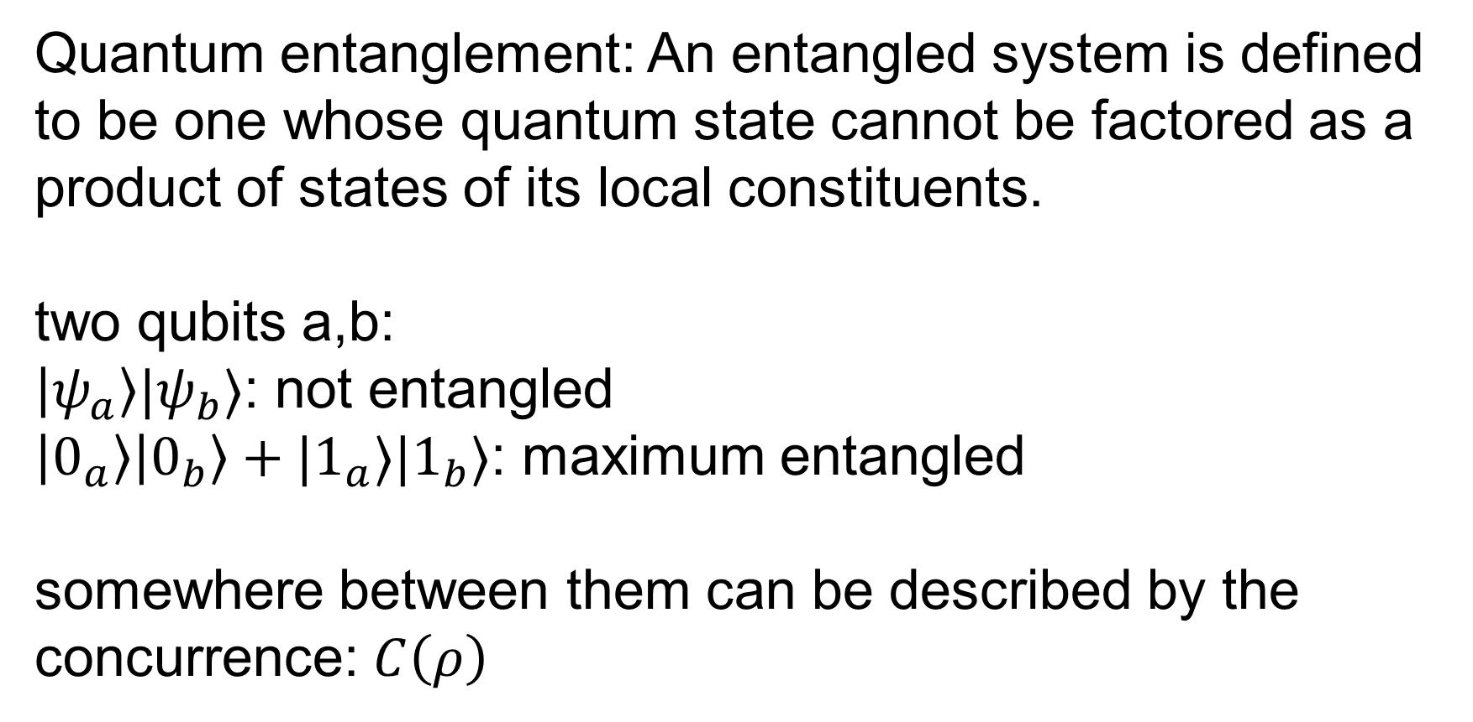
Quantum entanglement: An entangled system is defined to be one whose quantum state cannot be factored as a product of states of its local constituents.
two qubits a,b:
$\left|ψ_{a}\right\rangle |ψ_{b}⟩$: not entangled
$\left|0_{a}\right\rangle \left|0_{b}\right\rangle +|1_{a}⟩|1_{b}⟩$: maximum entangled
somewhere between them can be described by the concurrence: $C\left(ρ\right)$

Slide 3
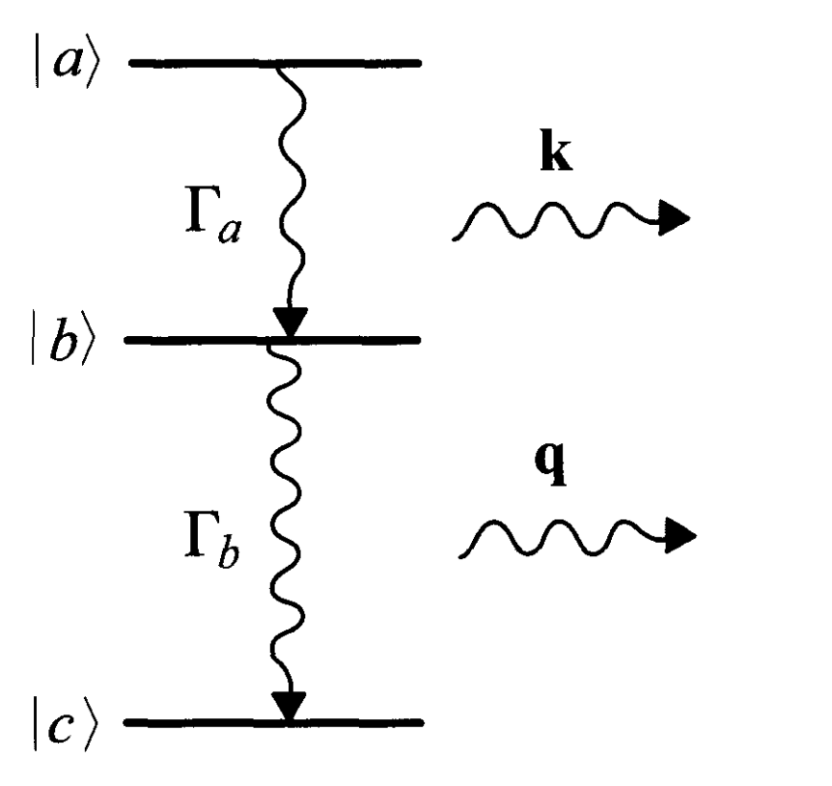
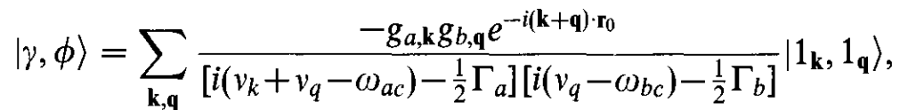
What about two photons?
difficulty: infinite number of modes!
eg: wave packet from two-photon cascade:
idea: convert it into the real space

Slide 4

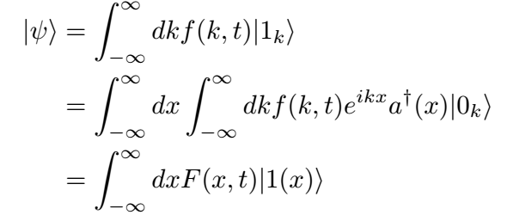
The wavefunction for a photon:
Fourier transform

Slide 5
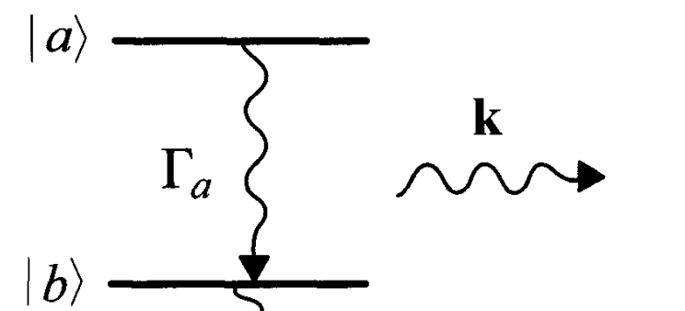
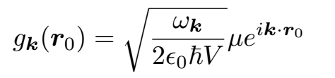


wavepacket from spontaneous decay (1D)

Slide 6
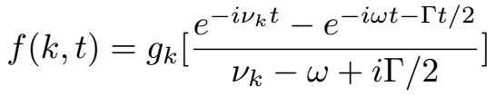
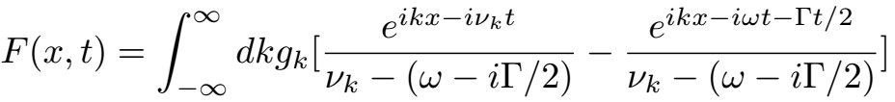
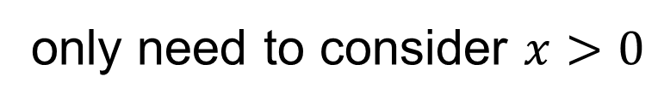


Wigner-Weisskopf approximation:
const
decay
steady state
$$+x$$
$$F\left(x,t\right)=F(−x,t)$$
atom
field point
only need to consider $x>0$

Slide 7
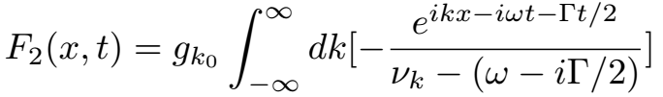
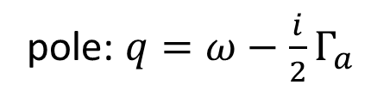
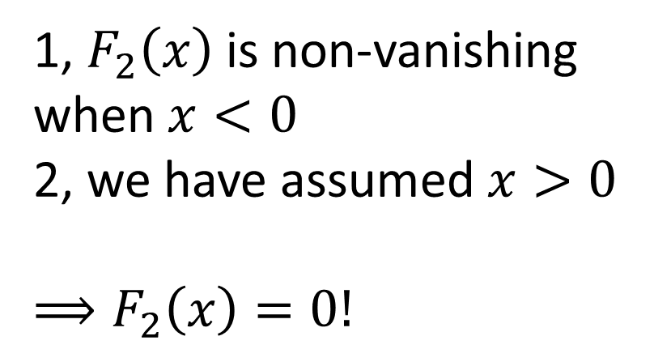
Fourier transform of the second term:
1, $F_{2}\left(x\right)$ is non-vanishing when $x<0$
2, we have assumed $x>0$
$$⟹F_{2}\left(x\right)=0!$$
pole: $q=ω−\frac{i}{2}Γ_{a}$

Slide 8
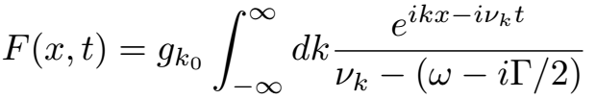

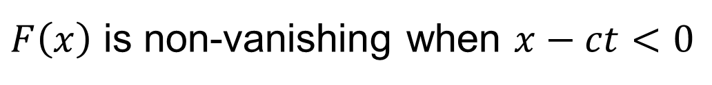
Fourier transform of the first term:
outgoing wave
incoming wave
$F\left(x\right)$ is non-vanishing when $x−ct<0$

Slide 9
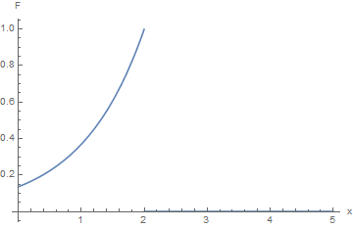

$$x=ct$$

Slide 10
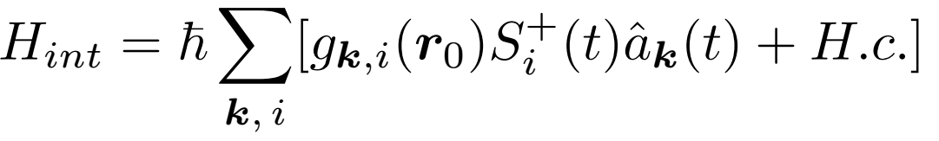
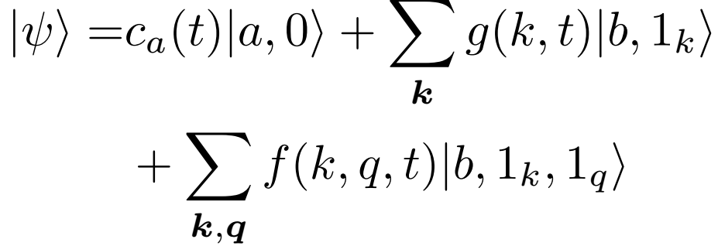
back to the two-photon cascade:

Slide 11
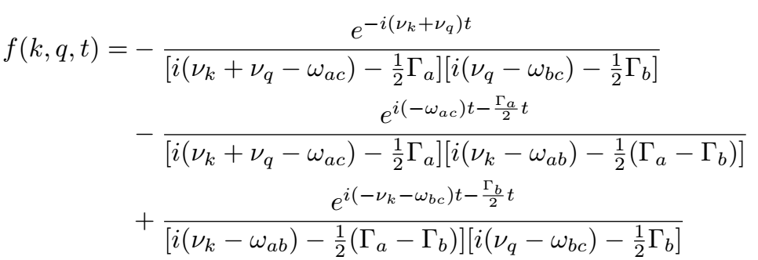
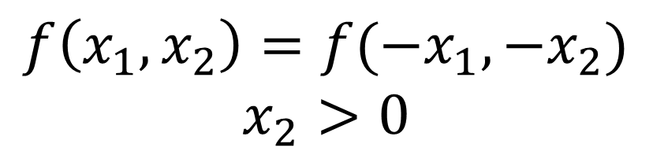
steady state
decay from |a>
decay from |b>
$$f\left(x_{1},x_{2}\right)=f(−x_{1},−x_{2})$$
$$x_{2}>0$$

Slide 12
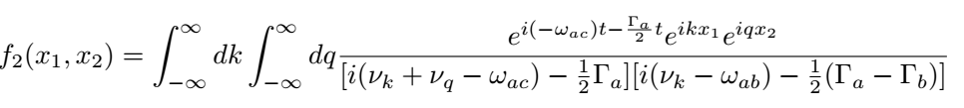
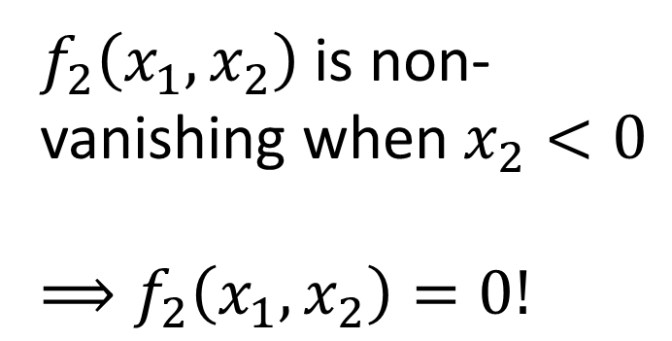
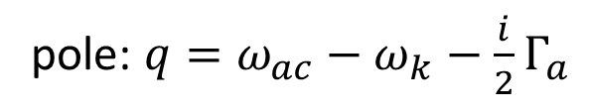
Fourier transform of the second term:
pole: $q=ω_{ac}−ω_{k}−\frac{i}{2}Γ_{a}$
$f_{2}\left(x_{1},x_{2}\right)$ is non-vanishing when $x_{2}<0$
$$⟹f_{2}\left(x_{1},x_{2}\right)=0!$$

Slide 13
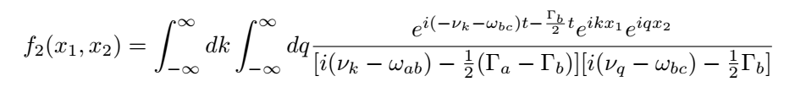
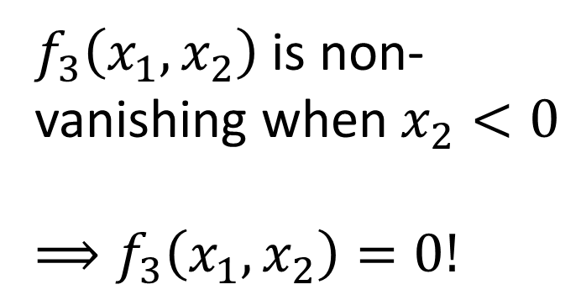
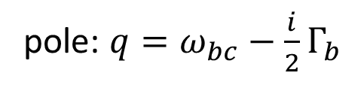
Fourier transform of the third term:
pole: $q=ω_{bc}−\frac{i}{2}Γ_{b}$
$f_{3}\left(x_{1},x_{2}\right)$ is non-vanishing when $x_{2}<0$
$$⟹f_{3}\left(x_{1},x_{2}\right)=0!$$

Slide 14
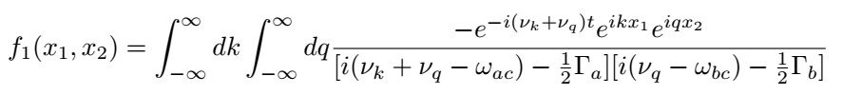
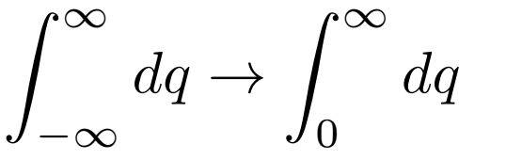
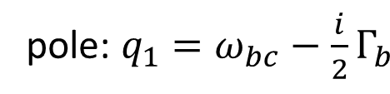
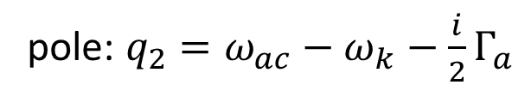
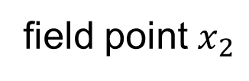
Fourier transform of the first term:
drop the incoming wave
$$+x$$
pole: $q_{2}=ω_{ac}−ω_{k}−\frac{i}{2}Γ_{a}$
atom
field point $x_{2}$
pole: $q_{1}=ω_{bc}−\frac{i}{2}Γ_{b}$

Slide 15
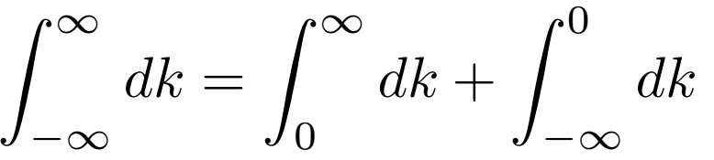




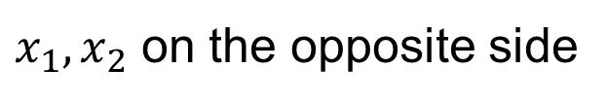

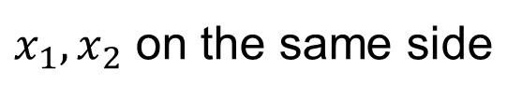

$x_{1},x_{2}$ on the same side
$x_{1},x_{2}$ on the opposite side
$$+x$$
$$+x$$
atom
$$x_{2}$$
$$x_{1}$$
$$x_{1}$$
atom
$$x_{2}$$

Slide 16
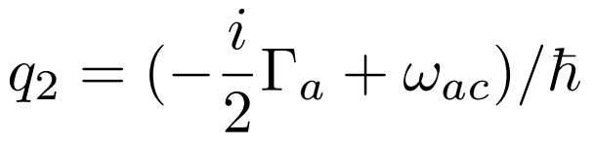

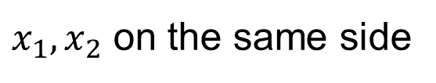


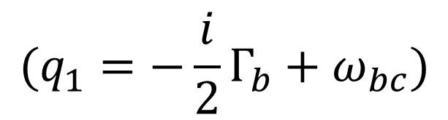
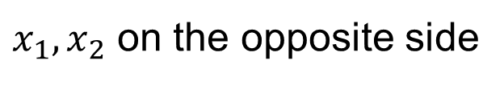

$$(q_{1}=−\frac{i}{2}Γ_{b}+ω_{bc})$$
redefine:
$x_{1},x_{2}$ on the same side
$x_{1},x_{2}$ on the opposite side
$$Imq_{2}>Imq_{1} (Γ_{a}<Γ_{b})$$
$$Imq_{2}<Imq_{1} (Γ_{a}>Γ_{b})$$
$$q_{2}−q_{1}$$
$$q_{2}−q_{1}$$

Slide 17
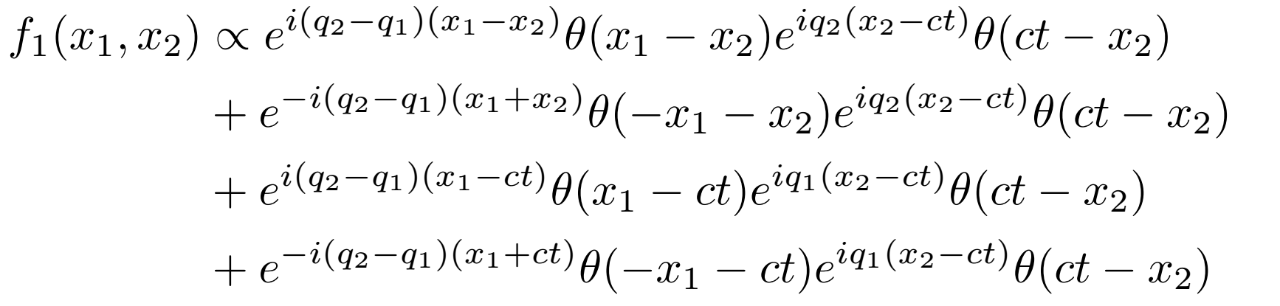


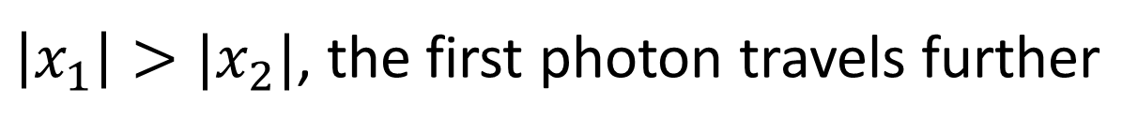
$$Imq_{2}>Imq_{1} (Γ_{a}<Γ_{b})$$
$\left|x_{1}\right|>|x_{2}|$, the first photon travels further
unentangled part, but $\left|x_{1}\right|>ct??$

Slide 18
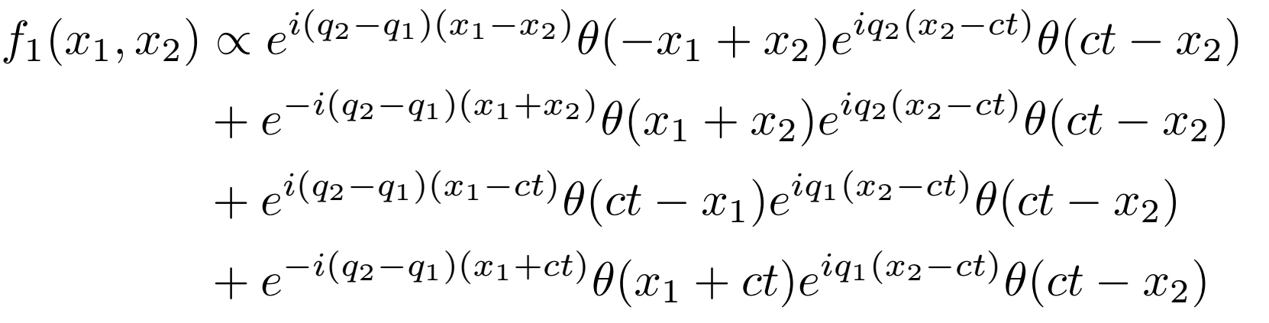

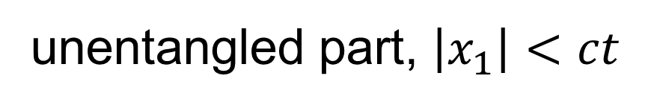
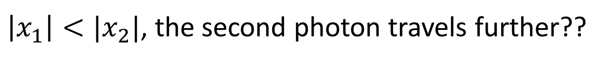
$$Imq_{2}<Imq_{1} (Γ_{a}>Γ_{b})$$
$\left|x_{1}\right|<|x_{2}|$, the second photon travels further??
unentangled part, $\left|x_{1}\right|<ct$

Slide 19
back to the two-photon cascade:
integrate k first due to causality

Slide 20
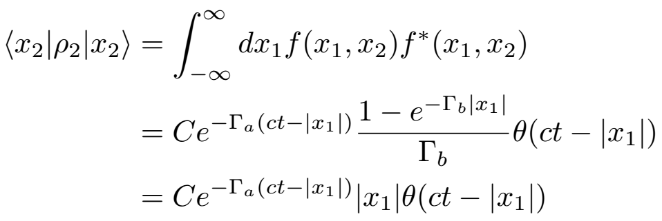
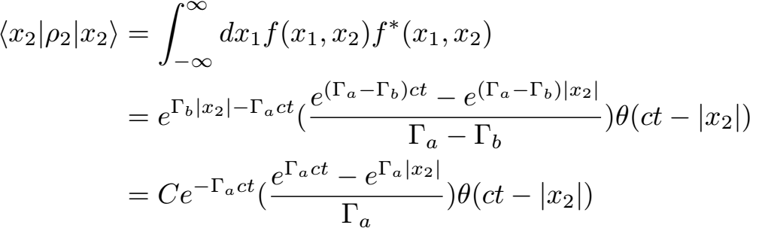
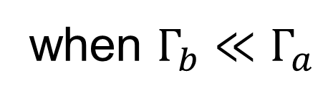
causality
when $Γ_{b}≪Γ_{a}$

Slide 21
